Slide 1

Customer Shopping Behavior Analysis
Analysis of 3,900 transactions to reveal spending patterns, segments, product preferences, and subscription behavior for strategic decisions.

Slide 2
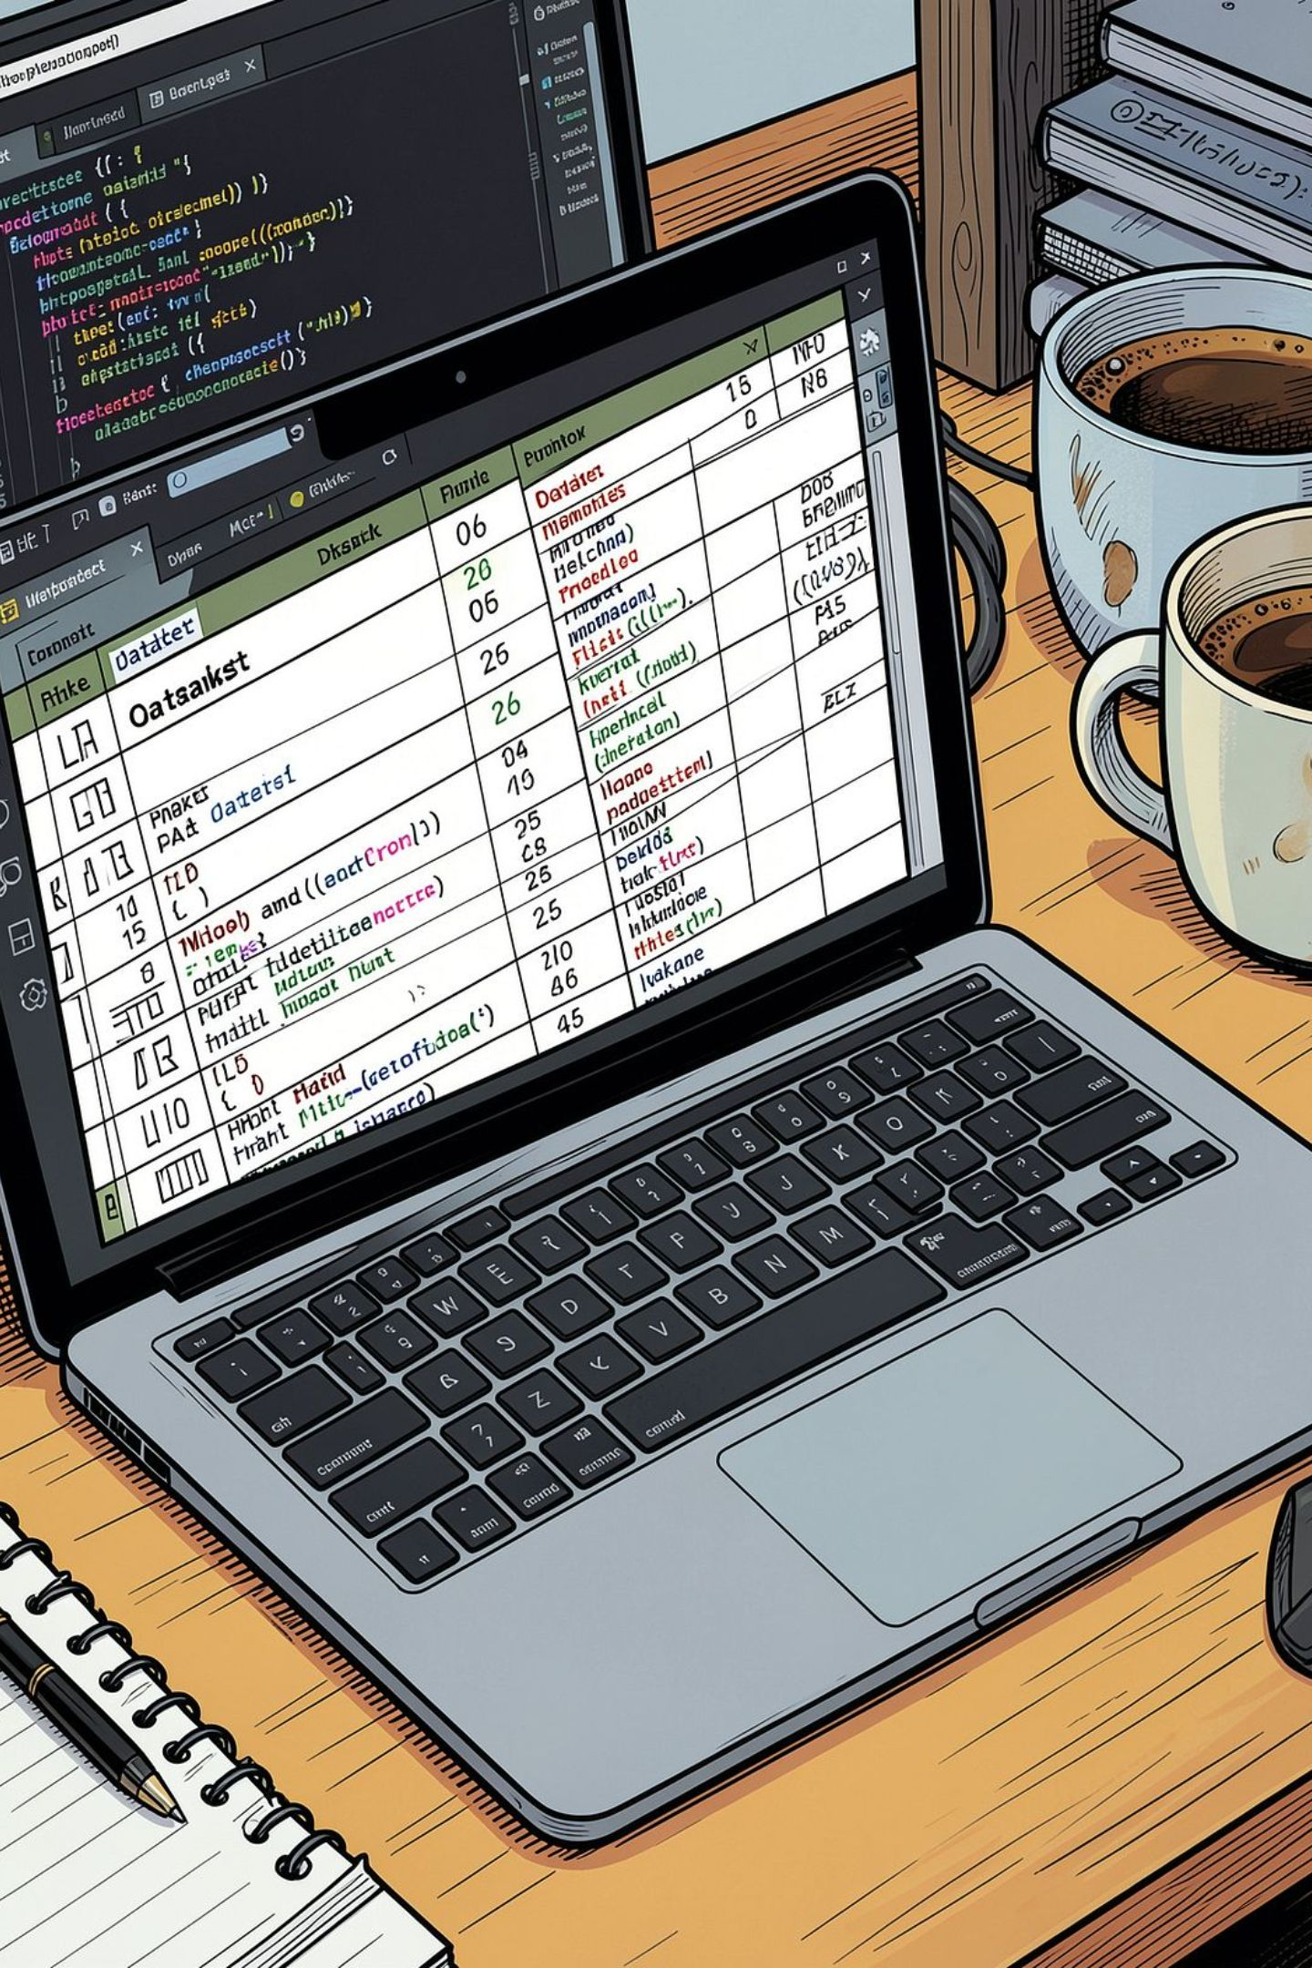
Dataset Snapshot
Rows & Columns
Key Features
3,900 rows · 18 columns
Demographics, purchase details, behavior, shipping, discounts
Missing Data
37 missing values in Review Rating

Slide 3

Data Preparation (Python)
Loaded with pandas, used df.info() and .describe(). Imputed Review Rating by product-category median. Standardized column names to snake_case. Engineered age_group and purchase_frequency_days. Dropped promo_code_used as redundant. Loaded cleaned data into PostgreSQL.

Slide 4

SQL: Revenue & Segments
Key SQL findings from PostgreSQL to answer business questions about revenue, discounts, product ratings, shipping, subscriptions, and segments.
Revenue by Gender
Male: 157,890 · Female: 75,191
Customer Segments
Loyal: 3,116 · Returning: 701 · New: 83
Subscribers vs Non
Yes: 1,053 customers (avg $59.49, revenue 62,645). No: 2,847 (avg $59.87, revenue 170,436).

Slide 5
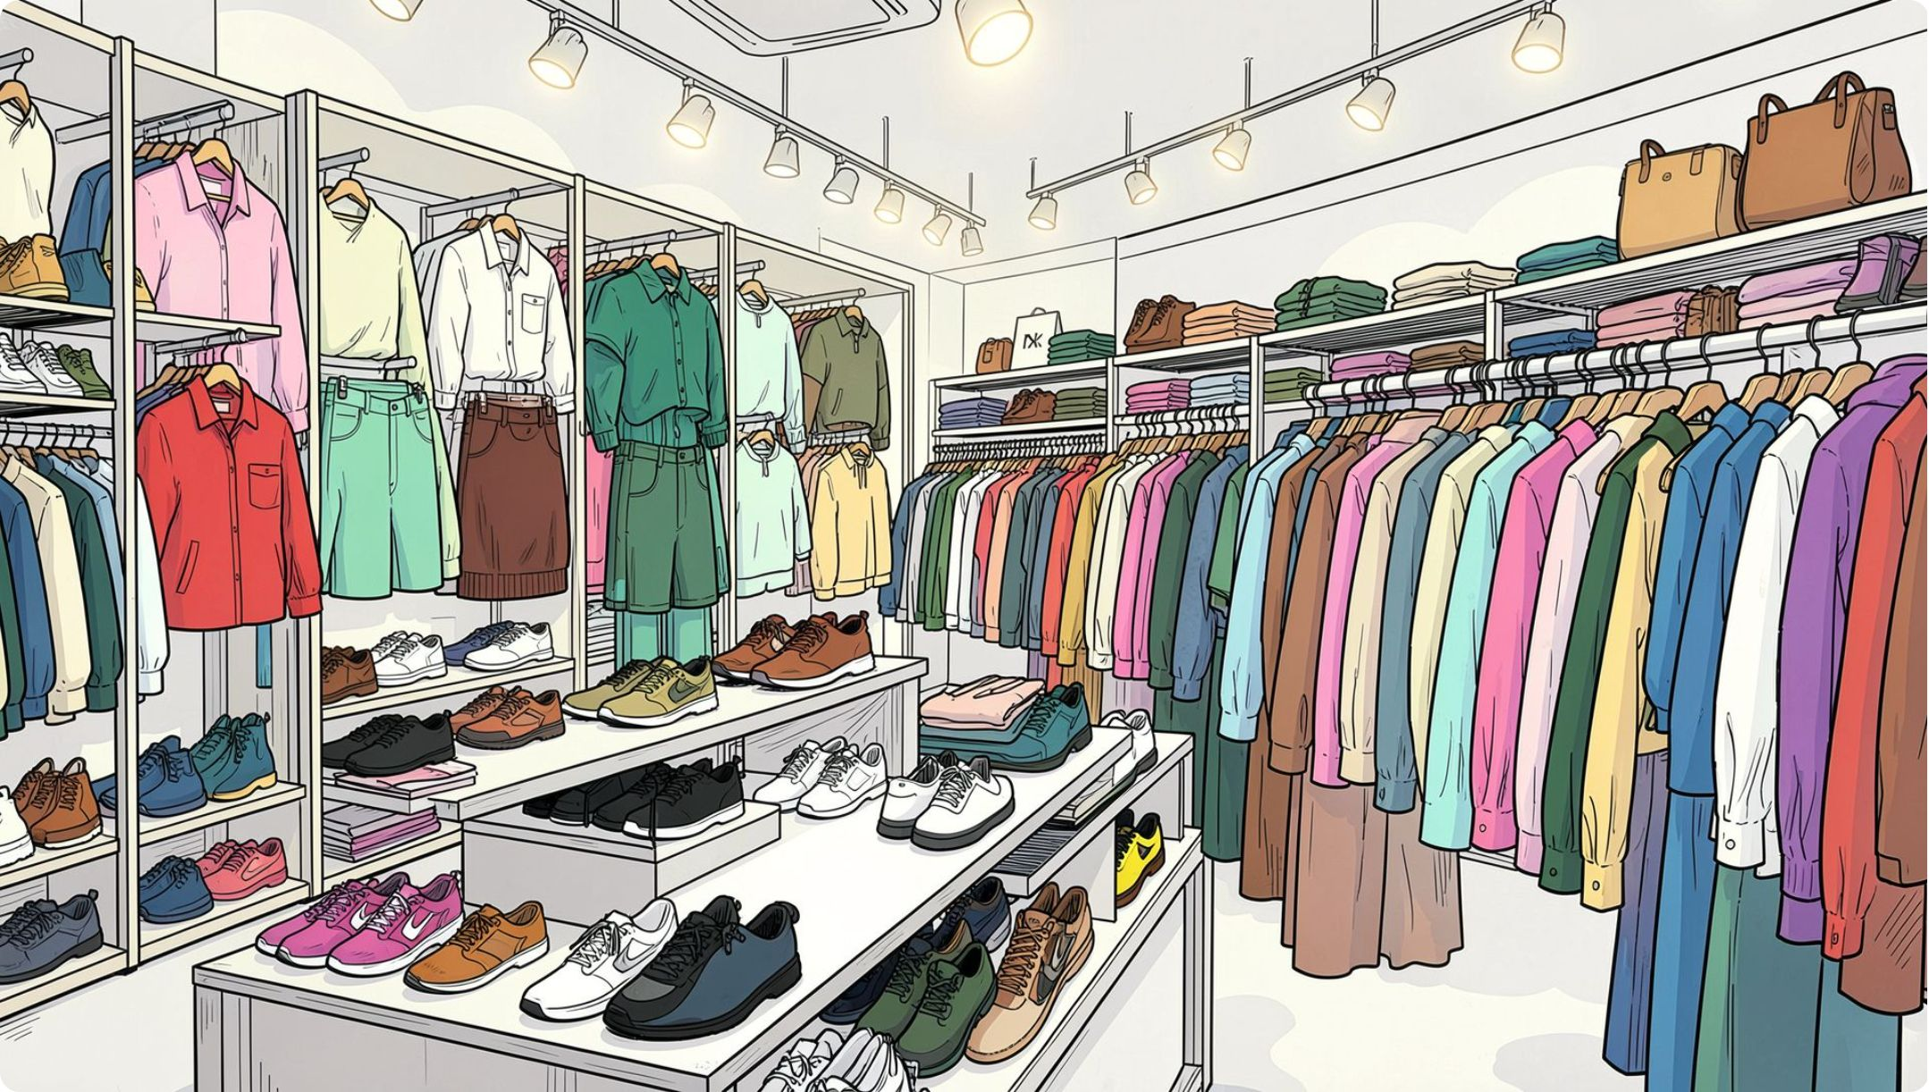
Product & Rating Insights
Top 5 products by average rating: Gloves (3.86), Sandals (3.84), Boots (3.82), Hat (3.80), Skirt (3.78).
Top products by category (sample): Accessories—Jewelry, Sunglasses, Belt. Clothing—Blouse, Pants, Shirt. Footwear—Sandals, Shoes, Sneakers. Outerwear—Jacket, Coat.

Slide 6
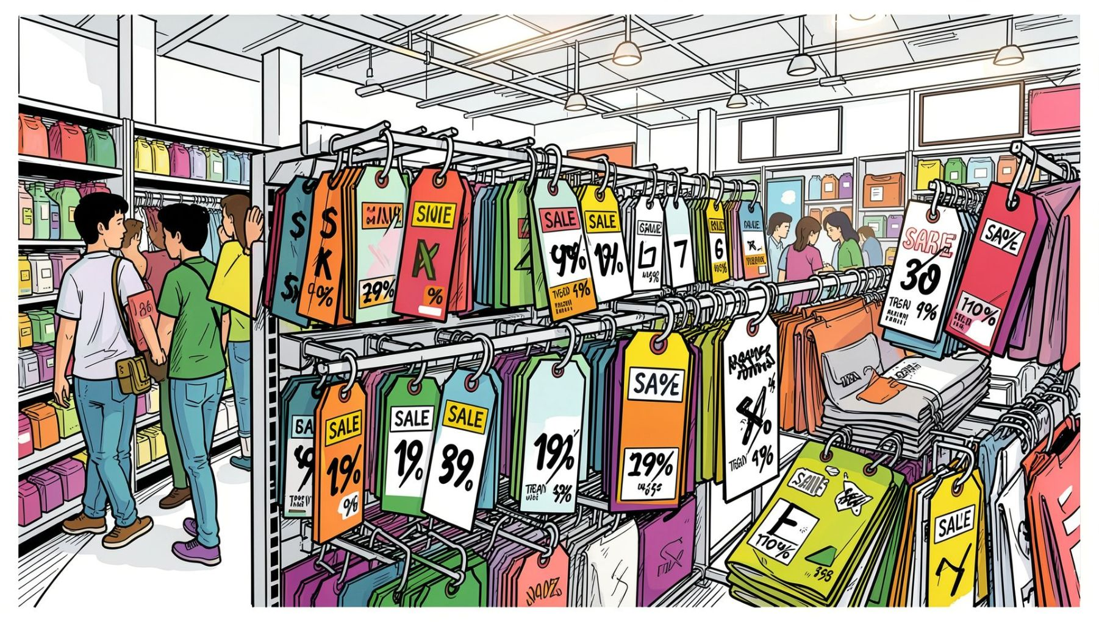

Discount & Purchase Behavior
839 rows of discount users who still spent above average. Top discount-dependent items by discount rate: Hat (50%), Sneakers (49.66%), Coat (49.07%), Sweater (48.17%), Pants (47.37).
Review discount policy to balance sales lift and margins.

Slide 7

Shipping & Spending
Shipping Comparison
Average purchase — Standard: $58.46 · Express: $60.48.
Payment & Frequency
Most used: PayPal. Common cadence: Every 3 Months.

Slide 8
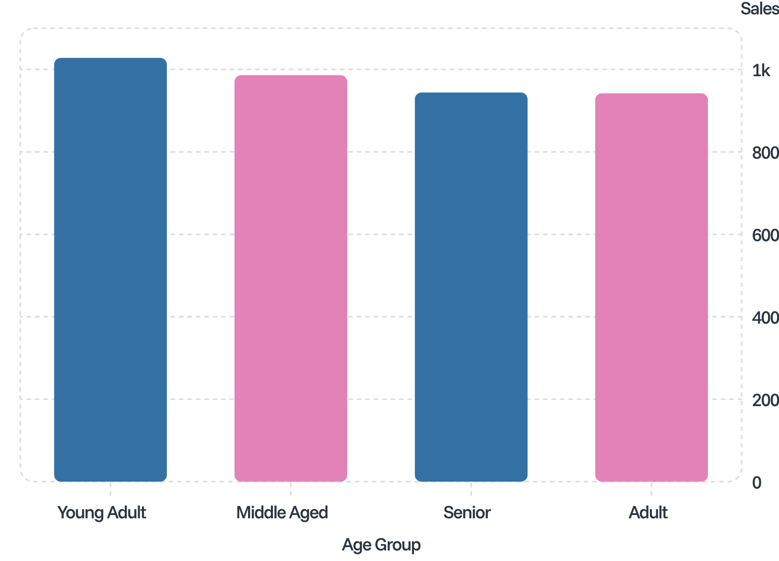
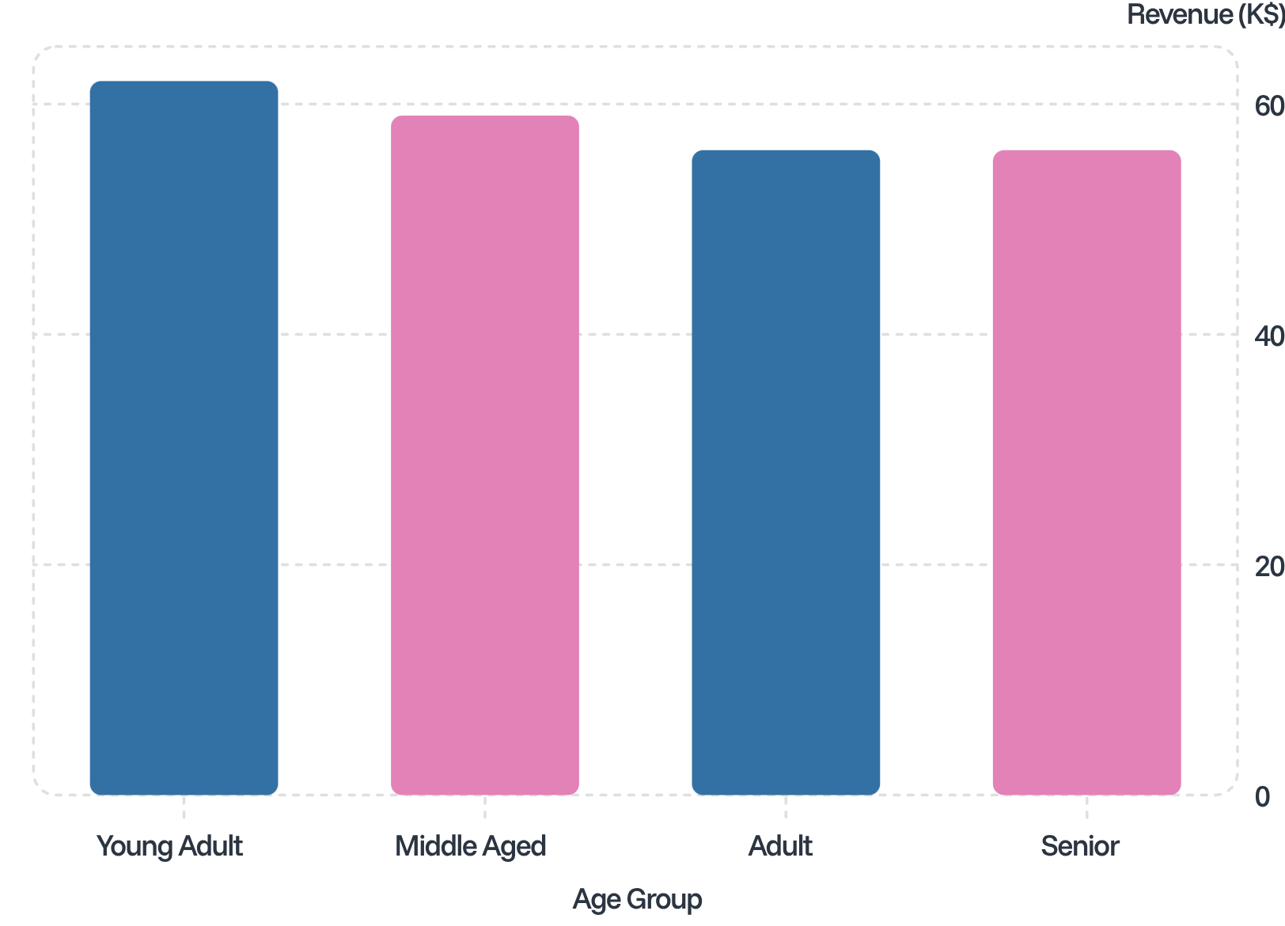
Age Groups: Sales & Revenue
Target marketing and product positioning toward high-revenue age groups (Young Adult, Middle Aged).

Slide 9
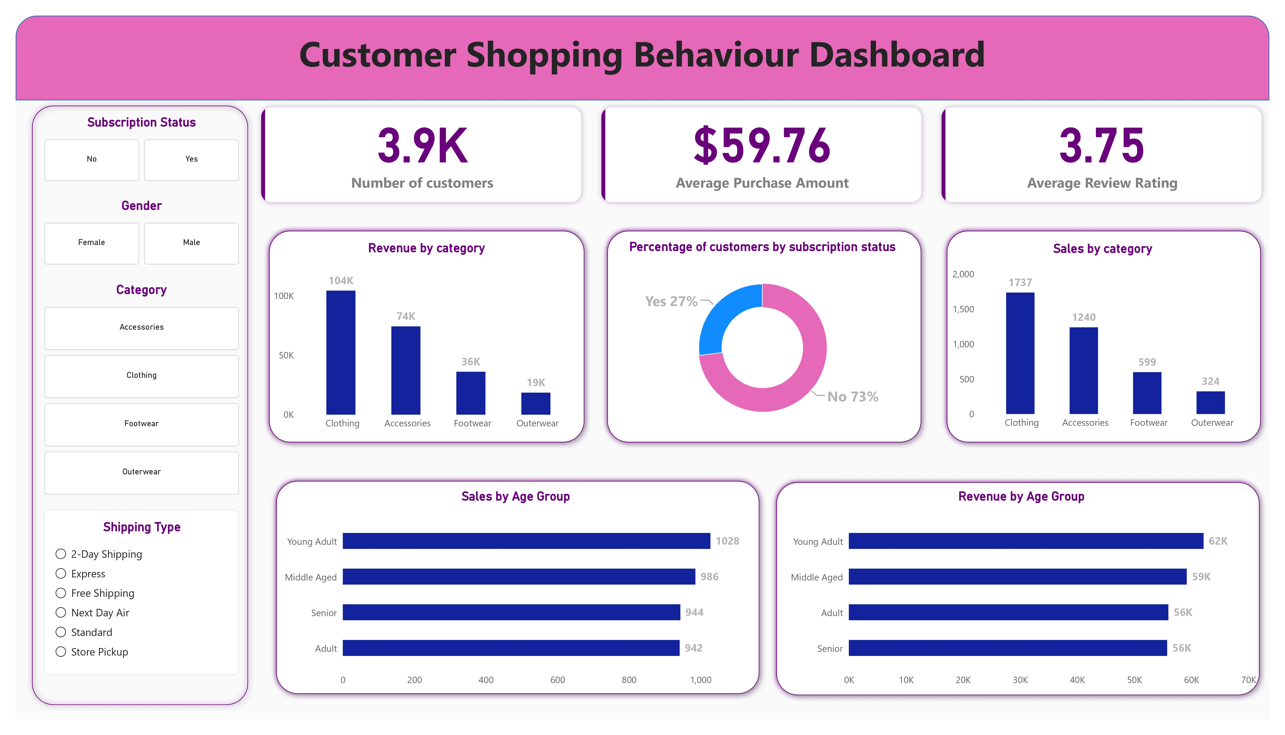
Dashboard Preview
Interactive Power BI dashboard summarizing KPIs, filters (Subscription Status, Gender, Category, Shipping Type), and charts for quick exploration.
Customers: 3.9K
Avg Purchase: $59.76
Avg Review Rating: 3.75

Slide 10
Business Recommendations
Boost Subscriptions
Customer Loyalty
Review Discount Policy
Product Positioning
Promote exclusive subscriber benefits to increase adoption and lifetime value.
Reward repeat buyers to grow the Loyal segment (3,116 customers).
Highlight top-rated and best-selling items (e.g., Gloves, Sandals, Jewelry, Blouse) in campaigns.
Balance discount-driven volume with margin preservation; focus on high discount-rate products.
Targeted Marketing
Focus on high-revenue age groups and express-shipping users for personalized promotions.

